Slide 1


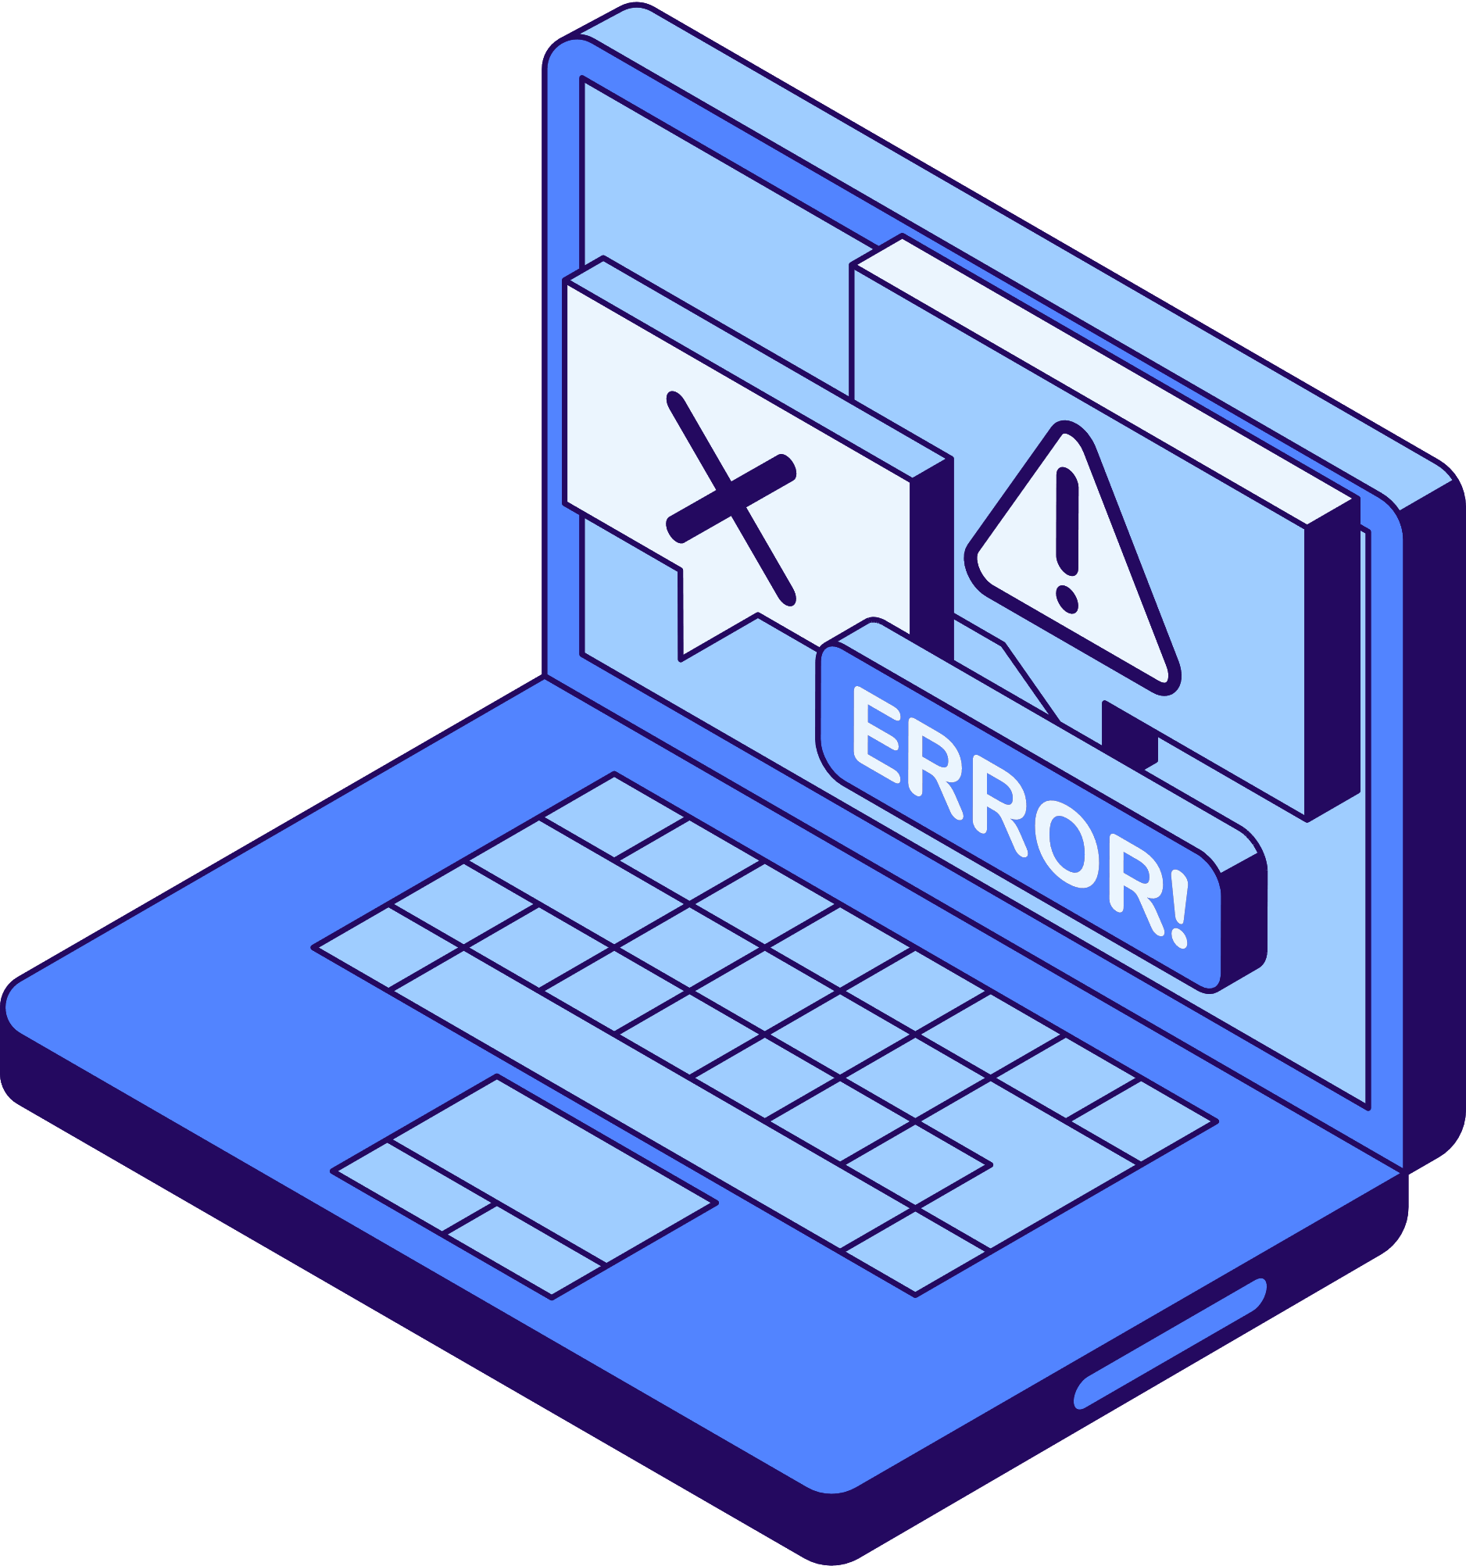
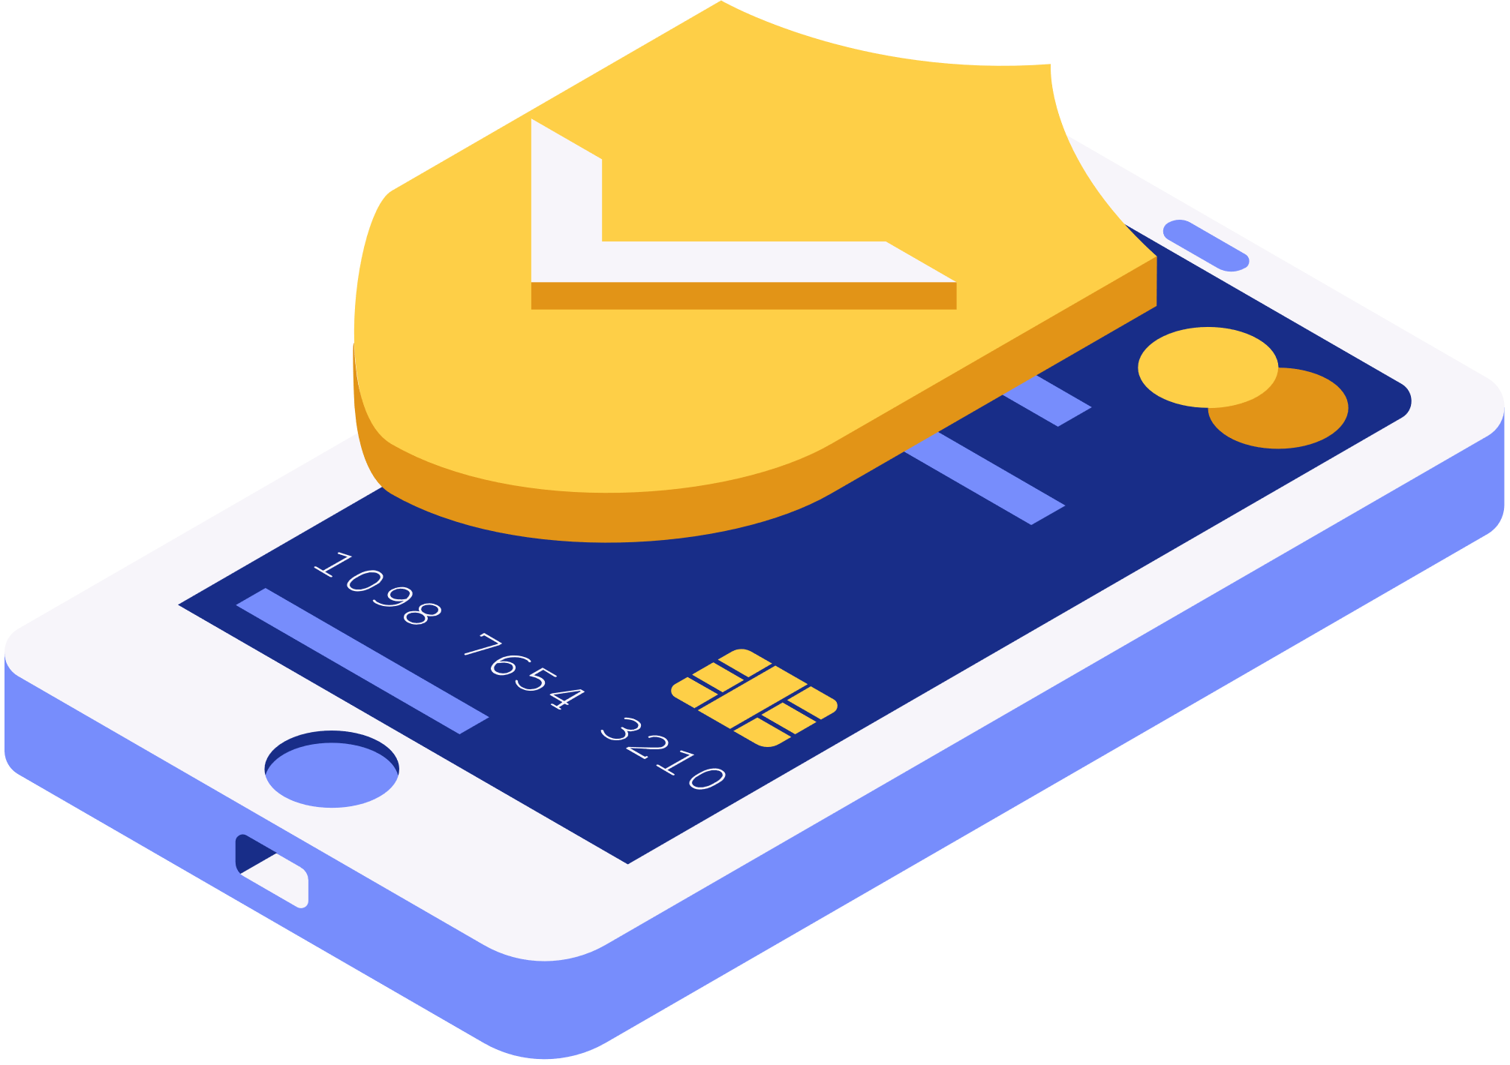

01/15
PHISHING AWARENESS TRAINING
Created by : HASSNAE ELKABIR

Slide 2
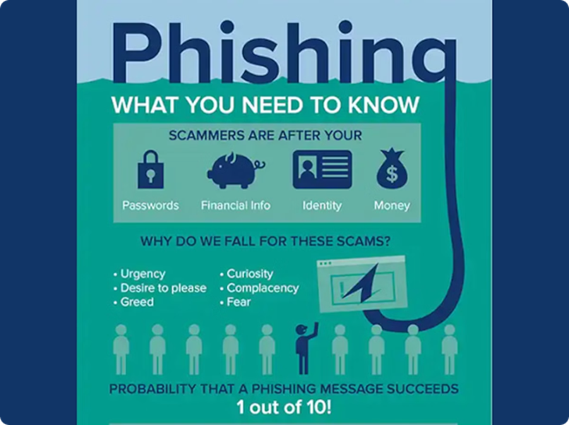
02/15
DEFINI
TION
Phishing is a form of online fraud where criminals try to trick you into revealing sensitive information.
This training will help you recognise and protect yourself from these kinds of attacks.
Created by : HASSNAE ELKABIR

Slide 3

03/15
They create fake websites that look like real ones, aiming to steal your login credentials or financial information.
WHAT IS
PHISHING?
Phishers send fraudulent emails that appear to be from legitimate organizations,
tricking you into clicking malicious links or providing personal data
Phishers may even call you, pretending to be from your bank or a government agency to obtain your sensitive info.
Created by : HASSNAE ELKABIR

Slide 4
04/15
PHISHING
TECHNIQUES
01
02
03
Urgency
Personalisation
Malicious Links
Phishing emails often create a false sense of urgency to pressure you into acting quickly without thinking.
Phishers may use your name or other personal details to make the email seem more legitimate.
Links in phishing emails often lead to infected websites designed to steal your information.
Created by : HASSNAE ELKABIR

Slide 5



05/15
Use Strong Passwords
Create unique, complex passwords for all your accounts to prevent credential theft.
PROTECTING
Enable 2-Factor Authentication
YOURSELF
Add an extra layer of security to your accounts by using 2FA.
Keep Software Updated
Install the latest security patches to protect against vulnerabilities.
Created by : HASSNAE ELKABIR

Slide 6
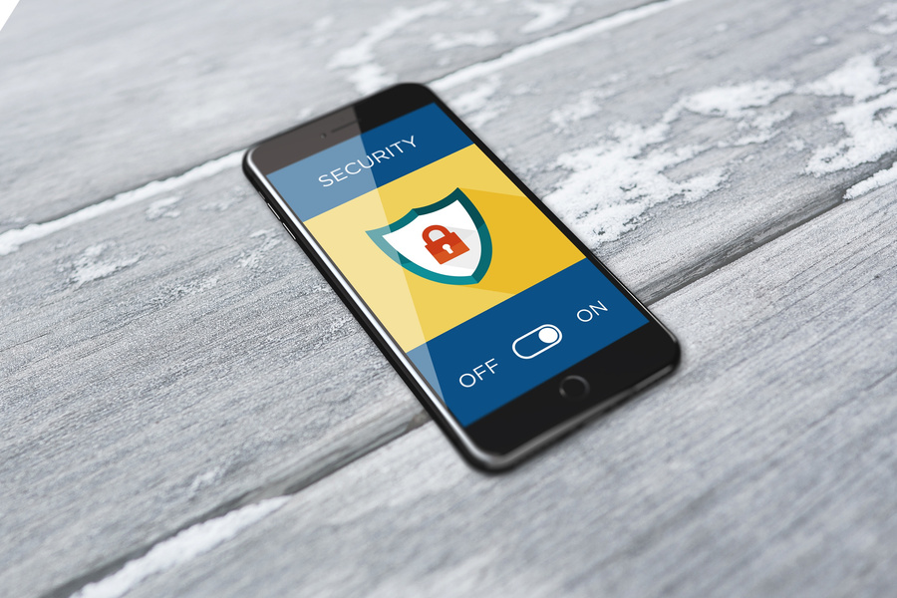



06/15
IDENTIFYING
PHISHING EMAILS
Check the Sender
Scrutinise Links
Verify the email address matches the company it claims to be from
Hover over links to check the URL before clicking - it should match the company.
Inspect the Content
Be Cautious
Look for poor grammar, generic greetings, and a lack of personalisation.
If something seems suspicious, don't engage - report it to your IT team.
Created by : HASSNAE ELKABIR

Slide 7

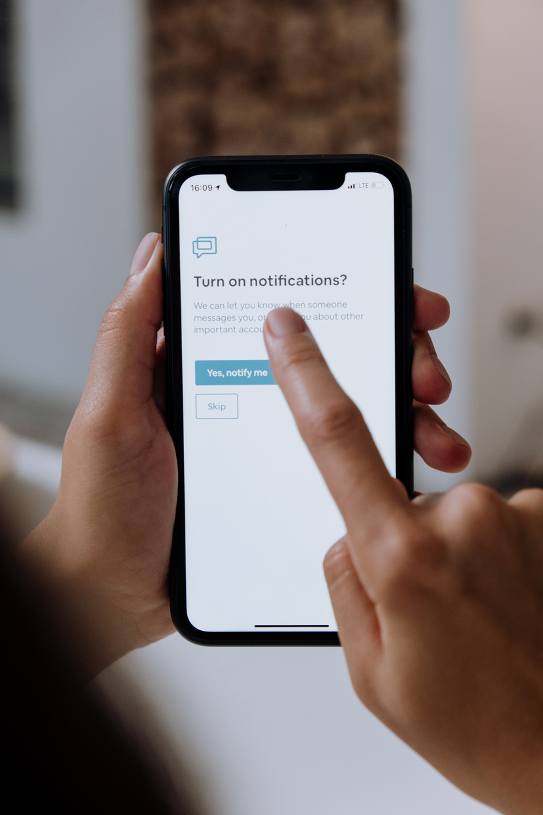
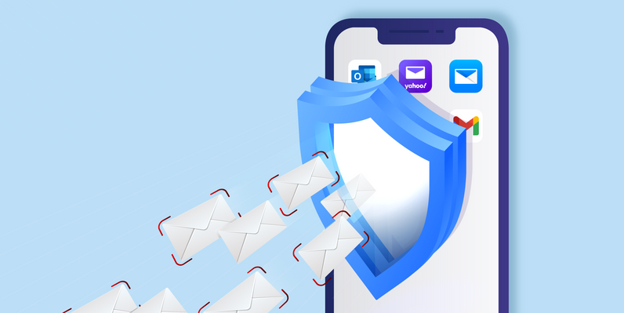
07/15
Forward to IT
Report any suspicious emails to your organisation's IT department.
REPORTING
Notify Authorities
PHISHING
If you've been a victim, contact the relevant authorities, such as the police or an anti-fraud organisation.
Block Senders
Mark phishing emails as spam and block the senders to prevent future attempts.
Created by : HASSNAE ELKABIR

Slide 8
08/15
CONSEQUENCES
OF PHISHING
Financial Losses
Data Breaches
Phishing scams can lead to theft of money, identity, and other valuable assets.
Successful phishing attacks can expose sensitive personal and corporate data.
Reputational Damage
Organisations hit by phishing may suffer a loss of trust and credibility.

Slide 9
09/15
THANK
YOU!
Created by : HASSNAE ELKABIR

